Slide 1
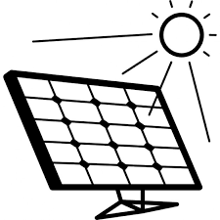
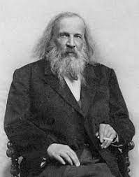
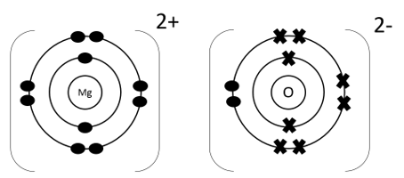
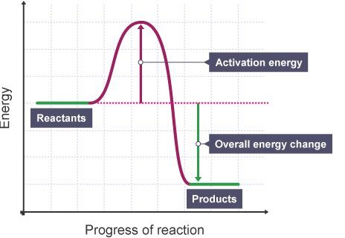
Year 9 LEARNING JOURNEY
St Michael’s Catholic School
RP: Photosynthesis
Working Scientifically Skills:
Recognising risks
Using formulae (FIFA)
Identification of variables
Selection & use of equipment
Recording results
Drawing conclusions
Year 10
Combined or triple science courses
Anaerobic respiration
Photosynthesis and factors affecting it
The heart
Breathing
Organisation animals and plants
RP : Food tests
Respiration
Photosynthesis
Aerobic
Respiration
Plant cells, tissues and organs
Exchange surfaces
Blood and blood vessels
RP: Factors affecting enzyme activity
Energy transfer by convection
RP: Specific heat capacity
Energy and the environment
Energy demands
Assessment:
Retrieval quiz
6 mark question
Energy transfer by conduction
Organisation and the digestive system
Structure of the digestive system
Working Scientifically Skills:
Making observations
Oral & written responses
Drawing conclusions
Infrared radiation and black bodies
Greenhouse effect and climate
Energy resources
Energy and power
Energy and work
HT: Improving efficiency of energy transfers
Groups 0 explaining trends
Group 7 explaining trends
Elastic potential energy
Fundamentals: of Physics
Oracy & Collaboration Project:
Pupils use their previous knowledge and understanding to produce materials on the theme ‘Preserving our Planet’
Gravitational potential energy and Kinetic energy
Groups 1 explaining trends
Energy pathways, dissipation and conservation of energy
Energy stores
Atoms and isotopes
Cell division
Stem cells
RP : Osmosis
Fundamentals: Chemistry
Development of the periodic table
RP : Looking at cells
Movement
in
Cells: Diffusion, osmosis,
active transport.
Growth and differentiation
Model of the atom
Electronic structure
Microscopes
Conservation of mass
Cells in animals and plants
Speed
Fundamentals of WS
Reactions
Fundamentals: of Biology
Acceleration
Exothermic & Endothermic reactions
Burning fuels
Atoms in reactions
Department Intent: To enable students to make evidence based, ethical and moral decisions so they can develop their scientific knowledge and skills
.

