Slide 1
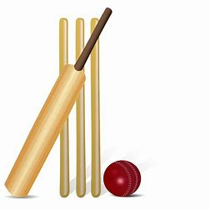
Year 8 Core PE
Learning Journey
To create versatile performers, establishing skills and techniques for success in sport and life
Game Play
Rules
OAA
Batting
Map reading
Year 9
PE
Middle distance
Tactics
Rounders
Coordinates
Fielding
Teamwork
Sprints
Movement
Bowling
Game Play
Throwing Events
Backhand Shots
Batting
Jumping Events
Serving
Game Play / Tactics
Cricket
Fielding
Outwitting Opponents
Athletics
Forehand Shots
Teamwork
Ccommunication
Boxercise
Circuit Training
Tennis
Summer term
Fitness
Problem Solving
Cardiovascular endurance
Leadership
OAA
Speed
Outwitting Opponents
Tactics
Accurate replication
Rules
Dribbling
Gym
Sequence
Rolls
Spring
term
Rugby
Passing
Aesthetics
Football
Defending
Rotation
Dance
Game play
Aesthetics
Dig - Set - Smash - Serve
Table Tennis
Attacking
Tactics and Strategies
Backhand shots
Autumn term
Forehand shots
Netball /
Handball
Rules
Game Play
Passing
Volleyball
‘The PE curriculum aims to support students in developing GOOD HABITS for LIFELONG PARTICIPATION, encouraging ASPIRATION, LEADERSHIP and CHARACTER DEVELOPMENT through a wide variety of educational experiences and enrichment activities.’

