Slide 1
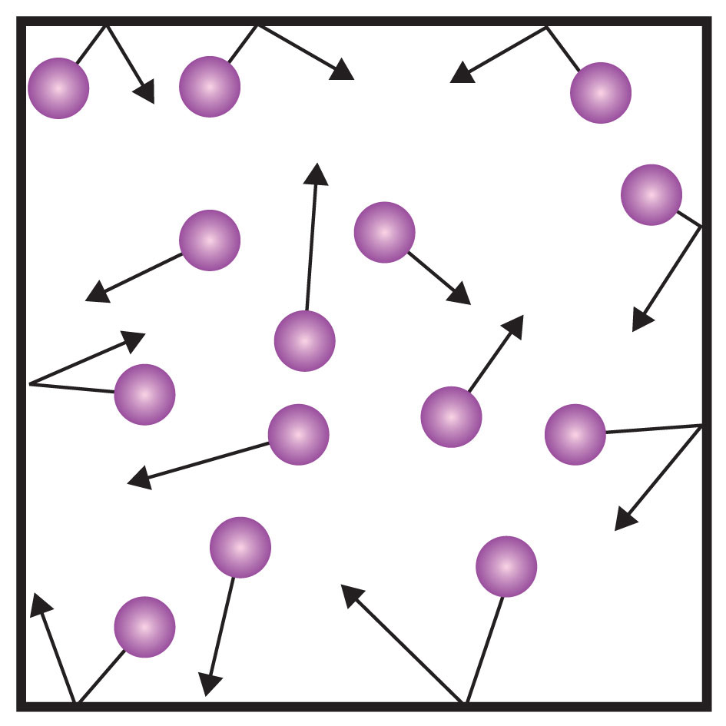
KS4 Trilogy Physics Learning Journey
St Michael’s Catholic School
PIN BANK
Simply drag a pin to add it to your journey
End of course revision and exams
Magnetic fields and electric currents
P13 Electromagnetism
A level Sciences – Biology, Chemistry and Physics​
Apprenticeships​
BTEC Level 3​
RP21: Absorption and emission of IR radiation
Magnetic fields
Uses for electromagnetic waves
Motor and generator effect
P12 Electromagnetic waves
RP: Force and acceleration
RP: Force and extension
Forces and elasticity
Electromagnetic spectrum
Speed and distance -time graphs
Velocity and acceleration
Momentum
P11 Waves properties.
Seismic waves
P9 Motion
Sound waves and their use
HEADING
Centre of mass
Velocity-time graphs
P10 Force and motion
Weight and terminal velocity
Wave properties
Reflection and refraction
Resolution of forces and parallelogram
Forces and breaking
RP: Measuring waves in a liquid and solid
What am I learning:
Resultant forces
Gas pressure and temperature
Internal energy and latent heat
Vectors and scalars
Uses for radiation
RP: Density
Year 11
States of matter
P8 Forces in balance
P6: Molecules and matter
Half lives
Alpha, Beta and Gamma radiation
Atoms and radiation
Changes of state
The national grid
P7: Radioactivity
Alternating current
Appliances, cables and plugs
P3 Energy resources
Energy resources
P4 Electric circuits
Static
Current and charge
Potential difference
P5 Electricity in the home
Mechanisms of energy transfer
Insulation
Energy demands
Modelling circuits
RP: Resistance
RP: Component characteristics.
RP: Specific heat capacity
CAR PARK
Work and power
Energy and efficiency
Conservation and dissipation
P1 Conservation and dissipation of energy
Why not
P2 Energy transfers by heating
Physics
Energy stores and pathways
Department Intent: To enable students to make evidence based, ethical and moral decisions so they can develop their scientific knowledge and skills.

